Slide 1


Organizational Behavior
(MGT-502)
Lecture-41

Slide 2
Today’s Topics

Slide 3
Review Part-III

Slide 4
Basic OB Model
Organization
systems level
Group
level
Individual
level

Slide 5
What are organizations?
Social entities
Goal oriented
Deliberately structured
Linked to the external environment

Slide 6
Characteristics Common to All Organizations
Hierarchy of authority
Coordination of effort
Division of labor
Common goal

Slide 7
Organizations as Systems
Task environment:
Competitors
Unions
Regulatory agencies
Clients
Structure
Inputs:
Material
Capital
Human
Outputs:
Products
Services
Task
Technology
People
(Actors)
Organizational Boundary

Slide 8
Organization Structure: Its Determinants and Outcomes
Causes
Strategy
Size
Technology
Environment
determines
Structural
designs
leads to
Mechanistic
Organic
Moderated by
Individual
Differences
Performance
and
Satisfaction

Slide 9
Chain of Command
Chain of Command
  The unbroken line of authority that extends from the top of the organization to the lowest echelon and clarifies who reports to whom.
Authority
  The rights inherent in a managerial position to give orders and to expect the orders to be obeyed
Unity of Command
  Only one direct superior

Slide 10
Span of Control
The number of subordinates a manger can efficiently and effectively direct.

Slide 11
Span of Control
Organizational Level

Slide 12
Strategy
Organization
Size
Why Do
Structures
Differ?
Technology
Environment

Slide 13
Elements of Organizational Structure
Department-
alization
Span of
Control
Organizational
Structure
Elements
Formalization
Centralization

Slide 14
Common Organizational Design
Simple Structure
Bureaucracy
Matrix Structure

Slide 15
The Distinguishing Feature of Job Design in the Future
Flexibility

Slide 16
Evolving Forms of
Organizational Design
Several new forms of organizational design
  Self-managing teams
  Team-based approach
  The virtual organization

Slide 17
Elements of the Environment
Technology
Political/Legal
The Organization
Sociocultural
Economic

Slide 18
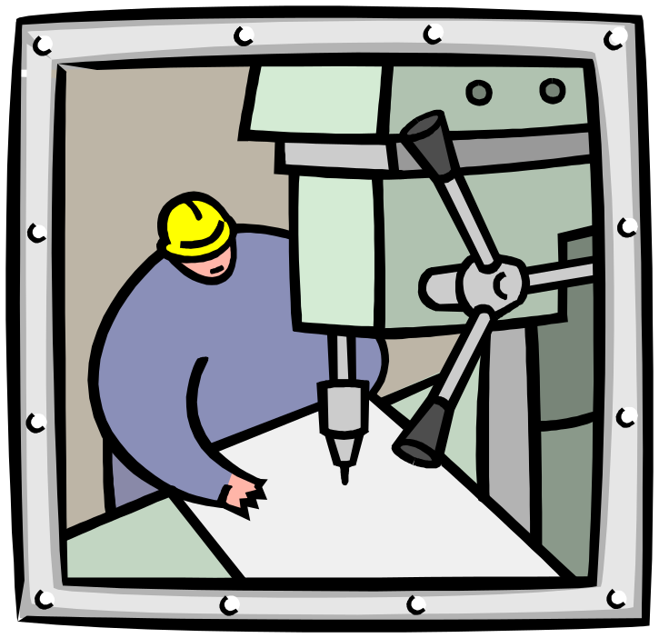
Work Design and Technology

Slide 19
Technology in the Workplace
Continuous Improvement Processes
  Good isn’t good enough
  Focus is on constantly reducing the variability in the organizational processes to produce more uniform products and services.
    Lowers costs and raises quality.
    Increases customer satisfaction.
  Organizational impact
    Additional stress on employees to constantly excel.
    Requires constant change in organization.

Slide 20
Process Reengineering
Rethinking and redesigning the processes by which the organization creates value and does work, ridding itself of operations that have become antiquated.

Slide 21
Work Space Design
Size
  The trend is away from traditional allocation of space based on organizational statue towards a flexible open space design that accommodates group and team activities.
Arrangement
  Open arrangements foster social interaction and influence the formality of relationships
Privacy
  Individual employee needs for workplace privacy are largely a function of the type of work that the employee does (e.g., programmers, HR managers, receptionists).

Slide 22
Work Schedule Options
Flextime: Employees work during a common core time period each day but have discretion in forming their total workday from a flexible set of hours outside the core.
Job Sharing: The practice of having two or more people split a 40-hour-a-week job.
Telecommuting: Employees do their work at home on a computer that is linked to their office.

Slide 23
Human Resource Policies and Practices

Slide 24
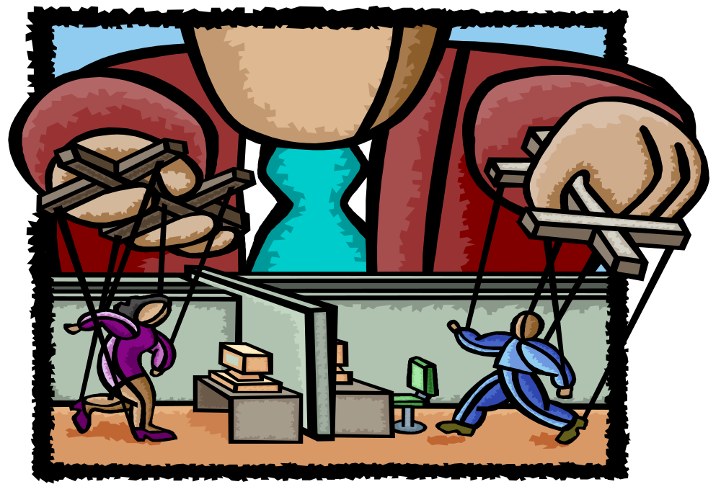

Slide 25

HRM Activities
Getting people
Preparing people
Stimulating people
Keeping people

Slide 26
Helps you ensure you get results - through others.

Slide 27

Managing Human Resources for This Era
Organizational ability
To Attract
To Develop
To Motivate and
To Keep talented people

Slide 28
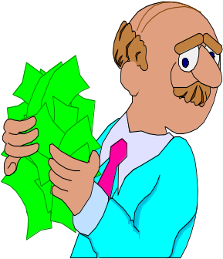
Successful HRM
Organization: High level of profitability, Higher annual sales per employee, High market value.
Employee: More employment security, More job opportunities, High wages.
Society: Elevating the standard of living, Strengthening ethical guidelines.

Slide 29
Equal
Employment
HR
Planning
Recruitment
Selection
HR
Research
HR
Development
Job Analysis
Employee
& Labor
Relations
Safety &
Health
Compensation
& Benefits
Performance
Appraisal

Slide 30
Selection
Will I get a job?

Slide 31
Socialization

Slide 32

Training

Slide 33
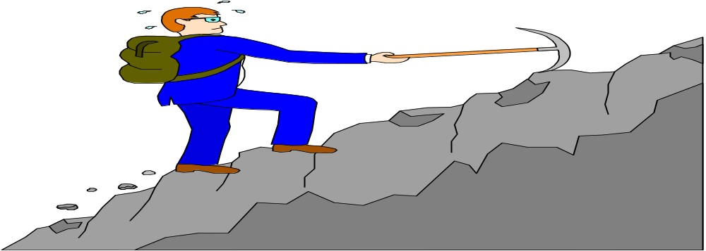
Career

Slide 34
Performance

Slide 35

Performance Appraisal

Slide 36
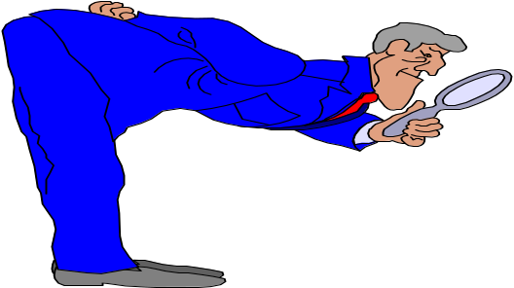
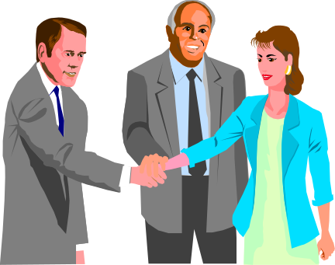
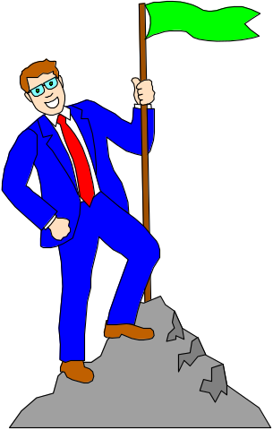
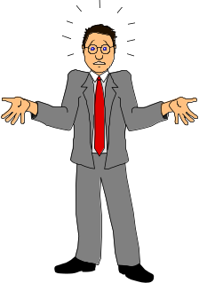
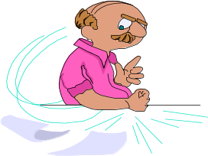
SUPERIOR
CUSTOMERS
SELF
PEERS
TEAM
SUBORDINATES

Slide 37
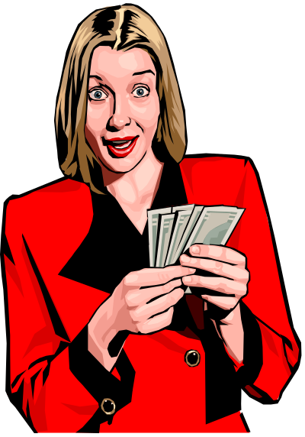
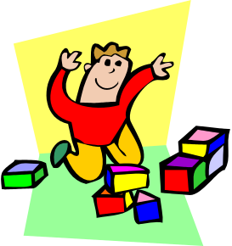
Employee Compensation

Slide 38

Unions

Slide 39

Organizational Culture

Slide 40
Organizational Culture Is
“The set of shared, taken-for-granted implicit assumptions that a group holds and that determines how it perceives, thinks about, and reacts to its various environments.”
- Edgar Schein

Slide 41
Stories
Rituals
How Employees
Learn Culture
Language
Material
Symbols

Slide 42
Four Functions of Organizational Culture
Organizational
identity
Sense-making
device
Collective
commitment
Organizational
culture
Social system
stability

Slide 43
Culture’s Effects on Behavior
Communication
Cooperation
Commitment
Decision Making
Implementation

Slide 44
Do Organizations have Uniform Cultures?
  Dominant culture
  Subculture
  Core values

Slide 45
How to Change a Culture
If the culture no longer supports the goals and strategy of an organization, it should be changed.
Mergers and acquisitions generally result in a change in culture.

Slide 46
Organizational Change

Slide 47

Species Must Change or They Will Die
Some have failed to change and have died

Slide 48
Some have changed and have thrived

Slide 49
Organizations, Too, Must Change or Die

Slide 50
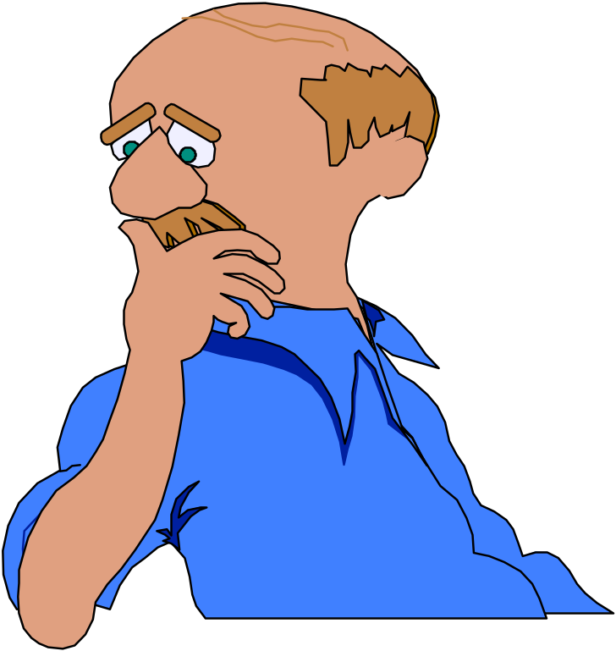
Change or Disappear

Slide 51
Forces For Change
External Forces
Economic Forces
Technology
Social and Political Change
Organizational
Change
Process
Behavioral
Internal Forces

Slide 52
Minimizing Resistance to Change
Communication
Minimizing
Resistance
to Change
Coercion
Training
Negotiation
Employee
Involvement
Stress
Management

Slide 53
The Change Agent’s Role
Change agent - the individual or group who undertakes the task of introducing and managing a change in an organization
The change agent can be internal or external
Notes:
8

Slide 54
Organizational Change
Unfreezing
Changing
Refreezing
Lewin’s Three-Step Process

Slide 55

Organizational Development
OD a set of techniques or tools that are used to implement organizational change

Slide 56
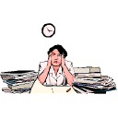
What is Stress?

Slide 57
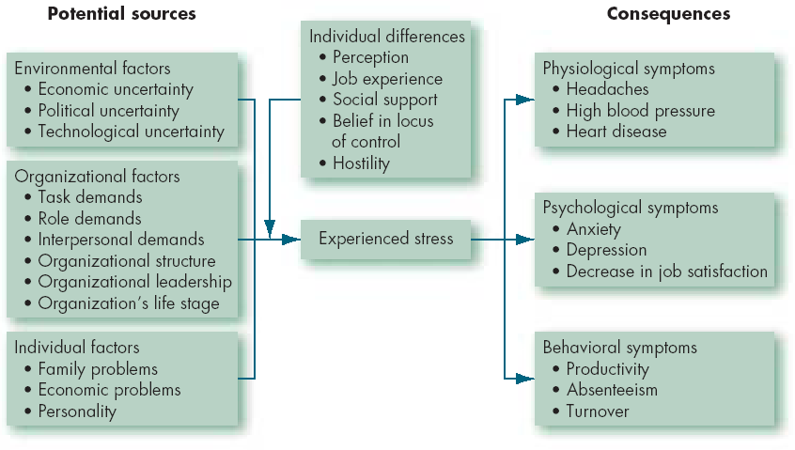
A Model of Stress

Slide 58
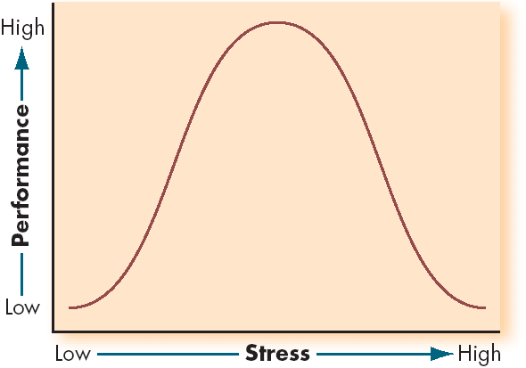
Inverted-U Relationship between Stress and Job Performance

Slide 59
Consequences of Stress
High Levels
of Stress
Physiological
Symptoms
Psychological
Symptoms
Behavioral
Symptoms

Slide 60
Recognizing Stress
Short-term physical symptoms
Long-term physical symptoms
Internal symptoms
Behavioral symptoms

Slide 61
Long-Term Stress
Performance
Healthy Tension Fatigue
Exhaustion
ILL HEALTH
BREAKDOWN
Stress

Slide 62

How to Manage Stress?

Slide 63
Recognizing Stress
Short-term physical symptoms
Long-term physical symptoms
Internal symptoms
Behavioral symptoms

Slide 64
Time
Management
Physical
Exercise
Individual Stress
Management
Relaxation
Training
Social
Support

Slide 65
Organizational Stress Management
Goal Setting
Wellness
Programs
Job
Redesigning
Organizational
Communication
Employee
Involvement
Selection
and Placement

Slide 66
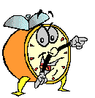
Let’s stop it here

Slide 67
Next….

Slide 68
Organizational Behavior
(MGT-502)
Lecture-41

